Slide 1
Chemical effects of electric current

Slide 2
What is an Atom?

Slide 3
An Atom
An Atom - The term "atom" comes from the Greek word for indivisible, because it was once thought that atoms were the smallest things in the universe and could not be divided. We now know that atoms are made up of three particles: protons, neutrons and electrons

Slide 4
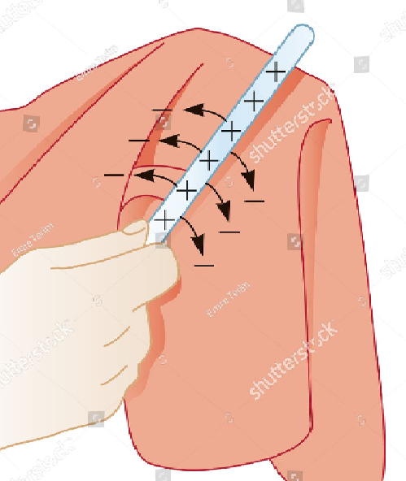
Electrons
Electrons get transferred from glass rod to silk
Number of electrons in glass rod is lesser than the protons in it .
Now acquires positive charge .
Silk cloth gains electrons and acquires negative charge.

Slide 5
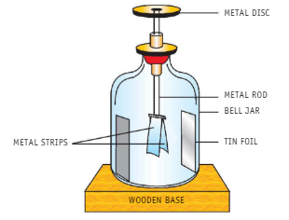
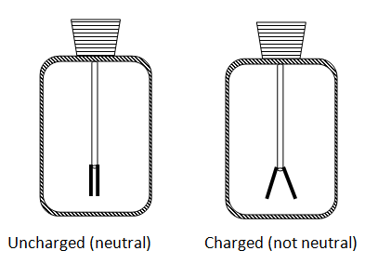
Electroscope

Slide 6
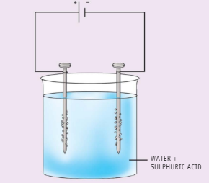
ELECTROLYSIS
Take two iron nails. Clean them with sand paper.
Wrap one or two rounds of copper
wire around them and connect the other ends of the wires to the two terminals of an electric battery.
Take water in a beaker
and add to it a little salt or a few drops of sulphuric acid to make it conducting.
Immerse the nails (called electrodes) in the solution.
Observe the nails carefully. Can you see small bubbles of gases coming out from the water near the nails?

Slide 7
ELECTROLYSIS
It can be checked that the gases evolved
are hydrogen and oxygen. Where did these gases come from?
What does this indicate?
The gases come from water—electric current breaks up water into its constituent gases, hydrogen and oxygen.
This observation, therefore, shows that electric current has a chemical effect on water.

Slide 8
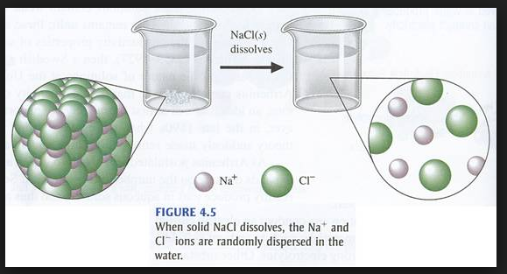
Ionisation
The process by which electrically neutral atoms or molecules are converted to electrically charged atoms or molecules (ions).
Na+ - Cation
Cl- - Anion

Slide 9
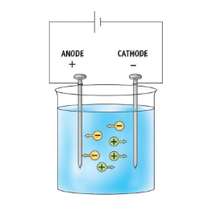
ELECTROLYSIS
A substance which conducts electricity in the liquid state or when dissolved in water and breaks up chemically during the process is
called an electrolyte.
The process of breaking up of an electrolyte chemically on passing an electric current through it is called electrolysis.
When an electrolyte such as copper sulphate is dissolved in water, it breaks up into positively and negatively-charged particles called ions.
Positively-charged ions are called cations while negatively-charged particles are called anions.
Ions move about freely in aqueous solution.
When electric current is passed through the solution, the cations move towards the negatively-charged electrode (cathode) and anions towards the positively-charged electrode (anode).
This results in a chemical change

Slide 10
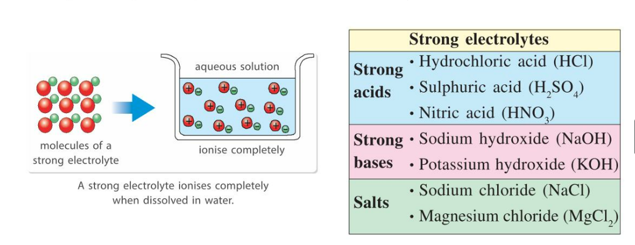
Strong Electrolyte
Strong Electrolyte- A compound when dissolved and ionizes completely.

Slide 11
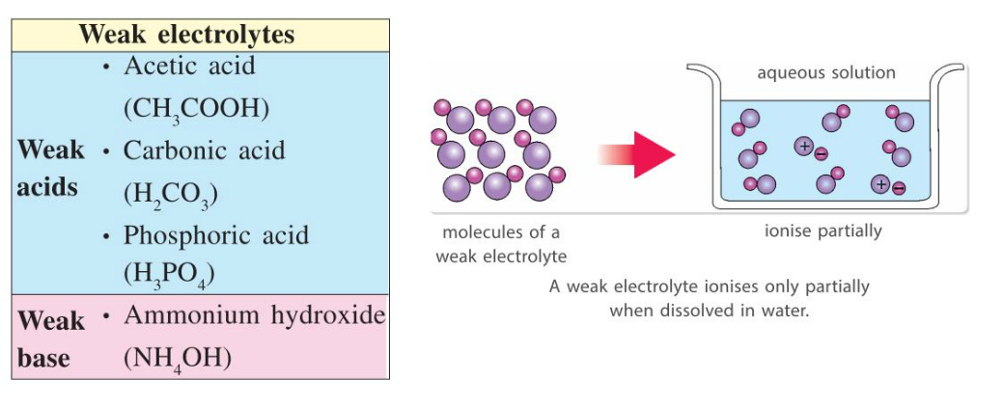
Weak Electrolyte

Slide 12
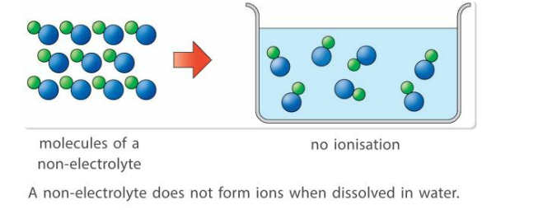
Non Electrolyte

Slide 13
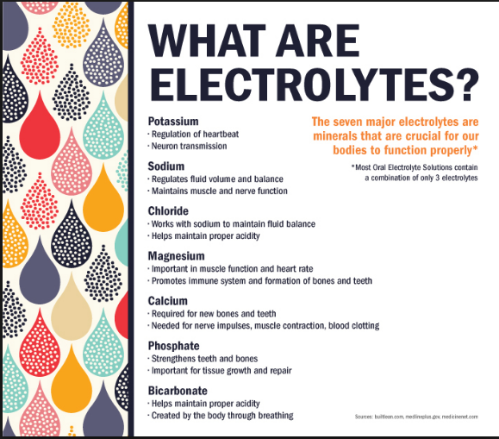

Slide 14
